Slide 1
Power Platform Master Class
Module 01: Getting Started with the Power Platform
Notes:
This module introduces students to the Microsoft Power platform and explains the role of canvas apps, connectors and flows in building business solutions. The module introduces the Common Data Service for Apps (CDSA) and explains how it provides support for creating custom entities and building model-driven apps. Students will create canvas apps with Power Apps Studio and learn to write advanced expressions for screen and control properties. The module examines connectors and data binding and demonstrates using the Start with Data template. Along the way students will learn to build a canvas app for mobile devices that reads and writes customer data to a table inside an Excel workbook in OneDrive for Business.

Slide 2
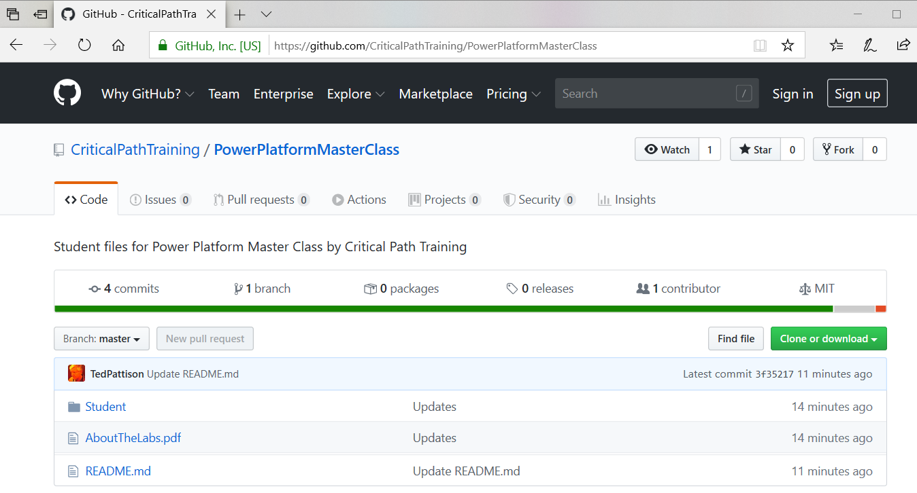
Downloading Student Files
Student files maintained in a GitHub repository
https://github.com/CriticalPathTraining/PowerPlatformMasterClass
Notes:
At Critical Path Training, we try our best to stay on top of all of Microsoft’s updates as they are applied to their cloud-based services such as Power Apps and Microsoft Flow. As you can imagine, this cloud cadence of monthly updates can pose a challenge to many training companies and content vendors who are faced with the problem of having to update their courseware on a monthly basis.
Critical Path Training has responded to challenge of dealing with monthly updates with a new student experience that we refer to as Live Labs. All the electronic student files for running demos and completing the lab exercises are published in a public GitHub repository which can be accessed with a browser at https://github.com/CriticalPathTraining/BBSPA/archive/master.zip.
It is recommended that you that you download the master zip archive and make a local copy of the Student folder so that you have a local copy of the files you will need on your computer workstation when going through these labs exercise. Once you download the master zip archive, open it and copy the Student folder to a new local folder. Note that each module of the course has its own folder in the Student\Modules folder.

Slide 3
Student Background Questionnaire
What is your name?
How will you be using Power Apps and Flow?
Which products and services do you work with?
Microsoft Excel
Power BI
Power Apps and Flow
SharePoint Online and Office 365
SharePoint On-premises
Dynamics 365
Others
Notes:
When you are called upon by the instructor, please provide a brief background by answering the following questions.

Slide 4
Agenda
Getting Started with the Power Platform
Creating Canvas Apps
Writing Power Apps Expressions
Working with Connectors and Data Binding
Understanding Delegation

Slide 5
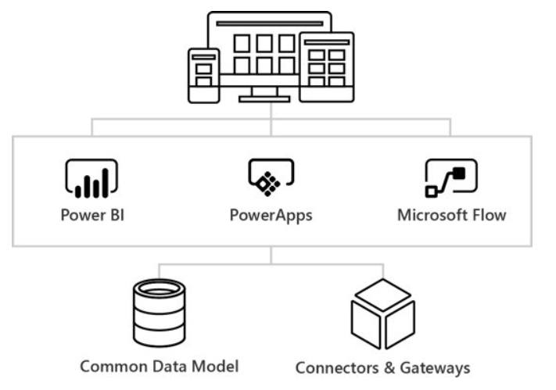
What is the Power Platform?
Power Platform
Power BI
Power Apps
Power Automate
Connectors and Gateways
Common Data Service
Notes:
Power Apps and Microsoft Flow are to important pieces of the Microsoft initiative known as the Power Platform. Together with Power BI, Power Apps and Flow make up the “Power Trio” of the Business Application Platform
The Power Platform has been specifically designed for business users and technical specialists who do not have the background of a software developer. The ultimate goal of the Power Platform is to allow business users and technical specialists within an organization to build custom applications and workflow solutions in a fraction of the time compared to the traditional lifecycle of a software development project. The Business Application Platform has also been designed with a mobile-first philosophy which makes it relatively easy and very effective to build applications that target mobile devices such as iPhones and Android phones.
The Power Platform consist of these services
Power Apps is a service for building and consuming web applications and mobile apps that connect to data
Microsoft Flow is a service for automating workflow across the growing number of apps and SaaS services
Power BI is a business analytics service which provides self-service BI and great interactive visualizations
The Common Data Service provides the native storage of business data in the Power Apps environment
Connectors and Gateways provide the Business Application Platform with access to external data

Slide 6
What Can You Build with Power Apps?
Canvas Apps
Built using Power Apps Studio
Flows
Used to process data and run workflows
Connections
Used to connect Canvas apps and flows to external data
Common Data Service (CDS) Components
Used to create business-centric data solutions
Model-driven Apps
Application platform built on top of CDS
Power Apps Portals
Website development platform built on top of CDS
Notes:
Canvas apps provide the flexibility to connect to a wide variety of data sources. They are built using Power Apps Studio. When you create canvas apps, you can use one of the 250+ connectors to create a connection to a specific database or service. The Microsoft Flow provides a browser-based designer for creating flows. A flow is a unit of executable logic that includes a trigger followed by parameterized actions.
The Common Data Service provides Power Apps and Dynamics 365 with the native Database storage format. It provides a standard set of database entities which can be used to store the data managed by business applications. Power Apps provides model-driven apps as an alternative to canvas apps. While canvas apps can use connectors to connect to any kind of external data source, model-driven apps only connect to the Common Data Service. A key advantage of model-drive apps over canvas apps is that they can use the built-in forms and views defined by Common Data Service entities which leads to a more productive, metadata-driven style of building applications.

Slide 7
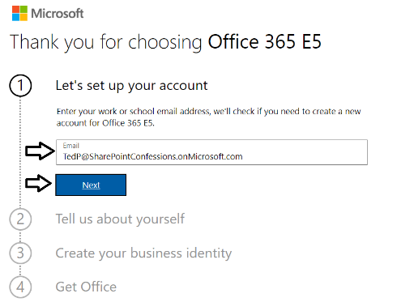
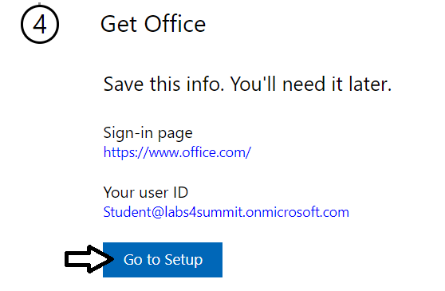
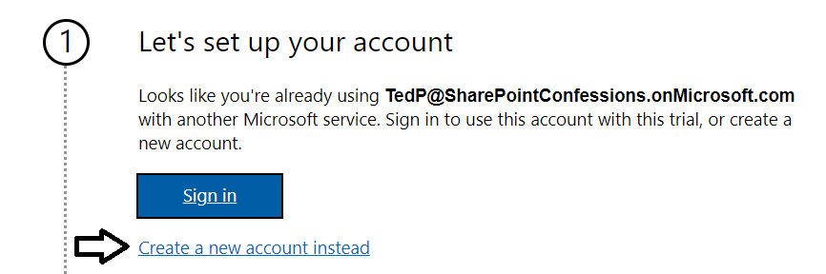
Creating an Office 365 E5 Trial Tenant
All students will create an Office 365 trial tenant
Provides an isolated development environment for lab exercises
Trial accounts will last for 30 days
Notes:
In the lab exercises for this course, you will go through the steps to sign up for an Office 365 Enterprise E5 trial account. By doing this you will create a new Office 365 tenant which makes it possible to create multiple user accounts. A key point here is that you are creating a trial account for an entire Office 365 organization as opposed to creating a trial account for a single user.
When you initially create the new Office 365 tenant, you will be prompted to enter the user name and password for a new user account. This initial user account will be created with full tenant administrator capabilities. This means that this accounts with have full administrative control over user management and group management within the Office 365 tenant. This account will also be able to see and modify the organization-wide administrative settings for important cloud services such as Azure AD, SharePoint Online, Power BI and, of course, Power Apps and Microsoft Flow.
A significant benefit of creating a test environment in this fashion is that you can create additional users which makes it possible to test Power Apps and Flow scenarios such creating custom connectors and configuring an On-Premises Gateway. An Office 365 Enterprise E5 trial account allows you to add up to 25 user accounts for testing purposes. You will also be able to create new Power Apps environments so you can create a setup where you build apps and other components in a development/staging environment and then practice how to package and deploy your work to a production environment.

Slide 8
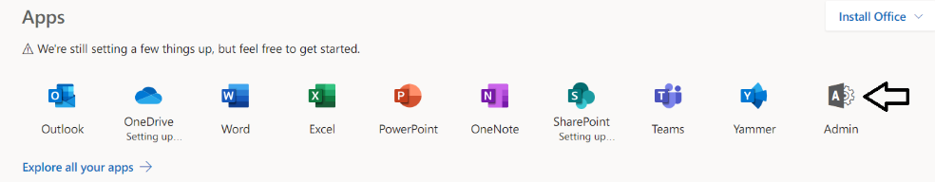
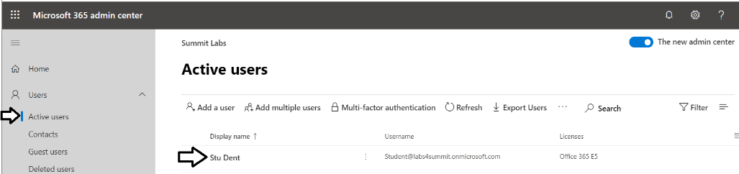
Microsoft 365 Admin Center
Navigate to the Microsoft 365 Admin center
Allows for management of users accounts and licensing
Notes:
Once you have created your new Office 365 Enterprise E5 trial account, you should become familiar with the process of navigating around inside the Office 365 Admin center. For example, you need to learn how to add new user accounts and groups. In the lab exercises, you will add a secondary user account for testing purposes. For most of the class, you will log in and complete your work using your primary user account which will have tenant-level administrative permissions. The benefit of creating a second user account is that you can log in and test your apps and flows with a typical user account which does not have any administrative permissions.
The Office 365 Admin Center also allows you to purchase new subscriptions and to start trial subscriptions. This is something you will be required to do. More on that as we move to the next slide.

Slide 9
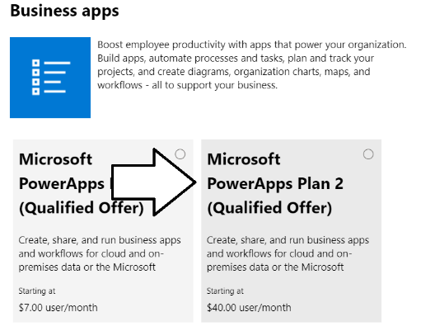
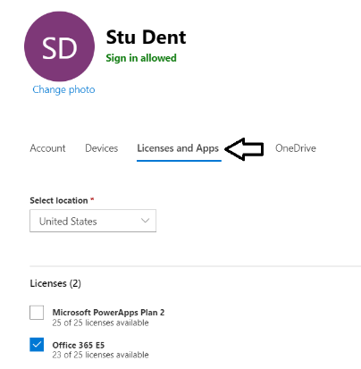
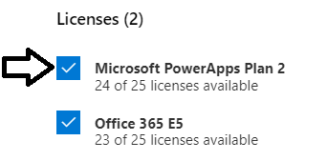
Configuring a Power Apps Plan 2 License
Certain design tasks require Power Apps Plan 2
You can start a 30-day trial for Power Apps Plan 2
License must be assigned to individual user accounts
Notes:
In the lab exercises for this module, there are instructions to configure your primary Office 365 user account with a Power Apps plan 2 license. The reason for this is that it provides you with the ability to view and create Power Apps environments and to work with the Common Data Service for Apps to complete design tasks such as creating a custom entity or a model-driven app.
Here are the high-level steps required to configure a Power Apps Plan 2 license.
Navigate to the Purchase services ion of the Office 365 admin center
Start a Trial Subscription of Microsoft Power Apps Plan 2
Configure Your User Account with a Microsoft Power Apps Plan 2 license
Note that the upcoming lab exercises for this module will provide you with the step-by-step instructions needed to complete these steps.

Slide 10
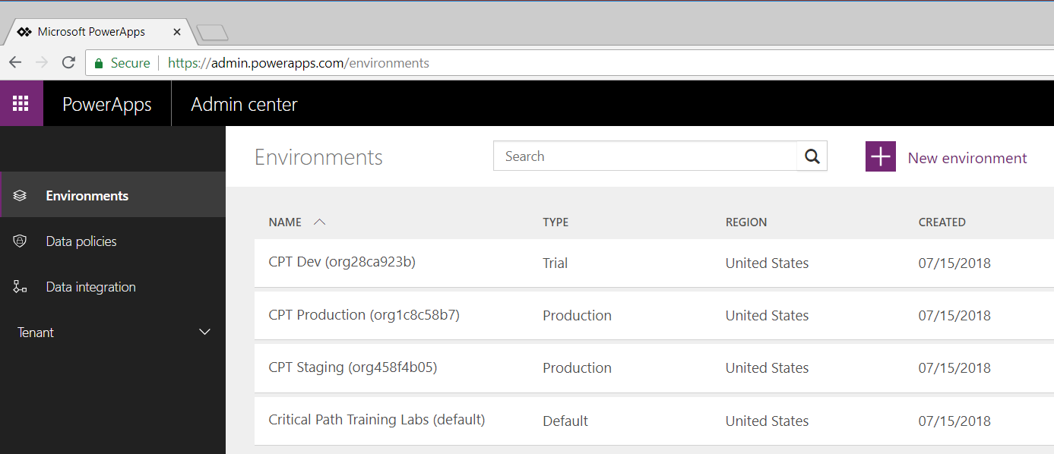
Power Apps Admin Center & Environments
Power Apps architecture based on environments
Environment provides context for creating apps and flows
Every tenant is automatically created with default environment
Organization can create multiple environments for dev & staging
Power Apps Plan 2 license required to manage environments
Notes:
The architecture for Power Apps and Flow is based on an important concept of “environments”. Any time you create a new app with Power Apps or a new flow, you are always doing so within the context of a specific environment.
You don’t have to think about environments when you start working with Power Apps. That’s because every new Office 365 tenant is automatically created with default environment. When you first begin to create apps and flows, you will be working within the default environment for the tenant that was created along with your new Office 365 trial account. During the first part of this training course, everything you do will be done in the default environment.
You can view and manage the environments for the current Office 365 tenant by navigating to the Power Apps Admin center at https://admin.Power Apps.com. Note that you will not be able to view existing environments or create new environments until your Office 365 user account has been assigned a Power Apps Plan 2 license.
This training course provides a module on application lifecycle management (ALM) with Power Apps and Flow. At that point, the instructor will go into greater detail about creating and managing environments. As you will learn, an organization can benefit from creating multiple environments to assist with developing and staging the apps and flows they build. After building and testing apps and flows in a staging environment, an organization can design a strategy for packaging and deploying them into a production environment.

Slide 11
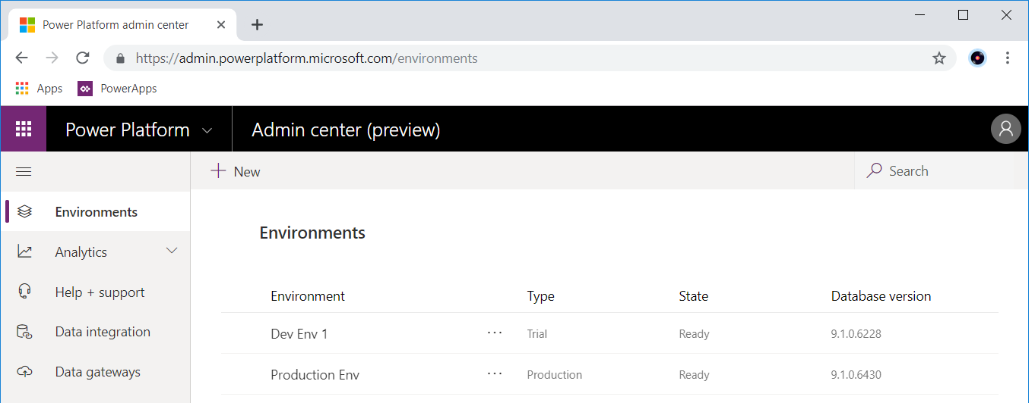
Power Platform Admin Center
Power Platform Admin center is admin UI of the future
Power Platform Admin center preview is missing many features
Power Platform Admin center should be main admin UI by 2020
Go to https://admin.powerplatform.microsoft.com/environments
Notes:
Microsoft has positioned the Power Platform Admin center as the full-featured admin UI experience of the future. As of Q3 2019, it is still missing many features which mean you must continue to use the older admin centers for Power Apps and Flow.
The work Microsoft needs to do to make the Power Platform Admin center full-featured should by complete by the beginning of 2020.
Go to https://admin.powerplatform.microsoft.com/environments to see what this admnin center looks like.

Slide 12
Configuring Power Apps Plan 2 Licenses

Slide 13
Agenda
Getting Started with the Power Platform
Creating Canvas Apps
Writing Power Apps Expressions
Working with Connectors and Data Binding
Understanding Delegation

Slide 14
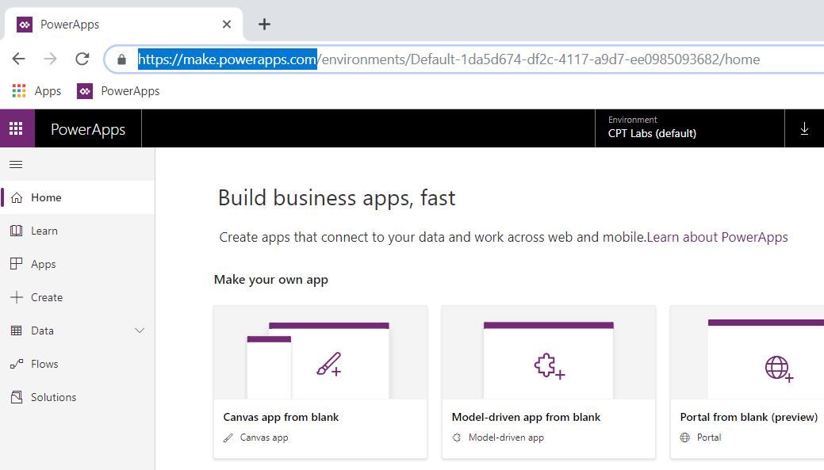
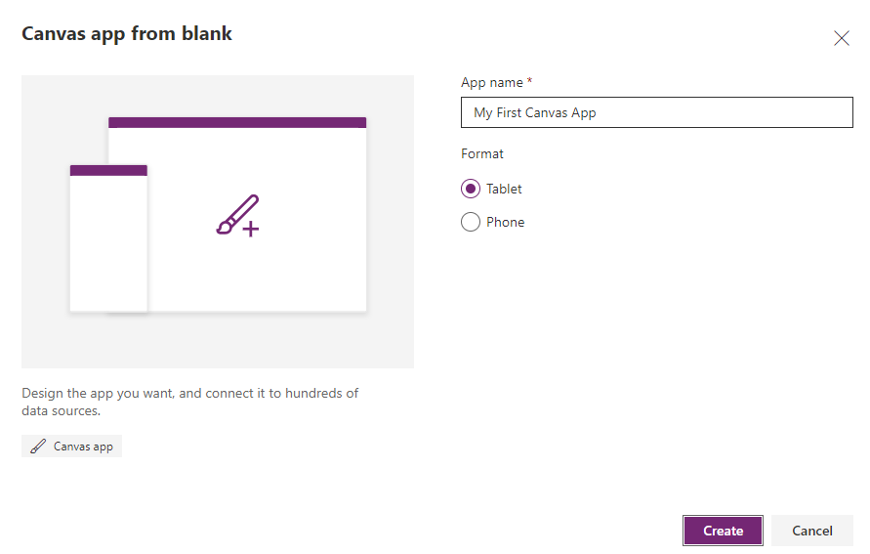
Creating a New Canvas App
Create Canvas apps from the Power Apps Home page
Navigate to https://make.PowerApps.com
Chose Canvas app from blank or Start from data
Choose between Phone form factor and Desktop/Tablet form factor
Clicking Create button redirects browser to https://create.PowerApps.com
Desktop or Tablet
Mobile Phone
Notes:
When you start using Power Apps, there are two important URLs that are easy to confuse with one another. The first is the URL to the Power Apps Home page which is located at https://make.Power Apps.com. The second is the URL to Power Apps Studio which is https://create.Power Apps.com. It’s important you understand the difference between these two locations.
You should navigate to the Power Apps Home page at https://make.Power Apps.com whenever you would like to create a new app or when you would like to play, edit or share an app you have already created. There is a navigation menu on the left which allows you to see and manage other Power Apps resources such as connections, custom connectors and custom entities in the Common Data Service for Apps.
Whenever you create a new app or you edit an existing app, you will be redirected to Power Apps Studio at https://create.Power Apps.com. In other words, Power Apps Studio is the place where you do all your work designing, testing and debugging the apps you create with Power Apps. When you navigate to Power Apps Studio, you will notice that the browser resolves to a URL that has a locale inside it as in the case of https://us.create.Power Apps.com.

Slide 15
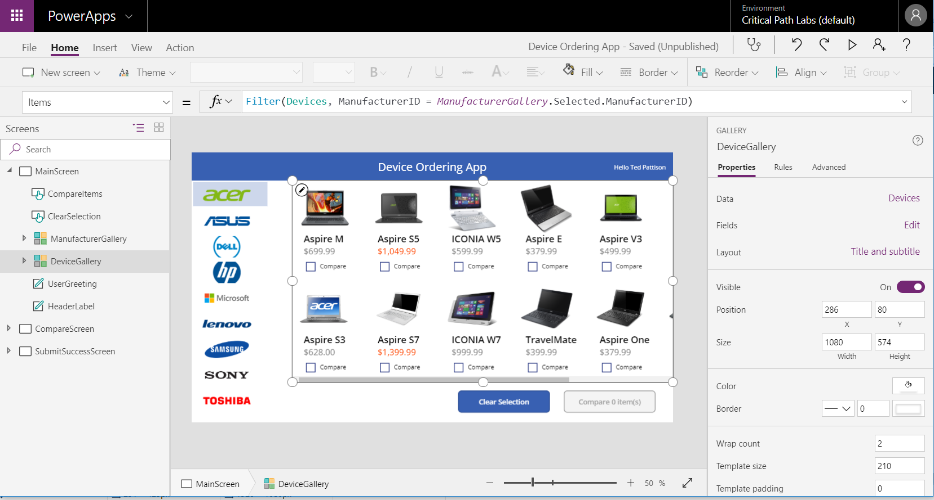
Getting Started with Power Apps Studio
Power Apps Studio for the Web is used to build apps
Environment supported across platforms (Windows & Mac)
Supports all popular, modern browsers
Notes:
If this is your first day using Power Apps, it will take a small bit of time to become accustomed to Power Apps Studio. In the first hands-on lab, you will get experience creating and building new apps. Once you create a new app, you must learn how to move from screen to screen and how to add new controls. You must also learn to set property values using the Properties pan and by writing formulas in the Formula bar.
Power Apps Studio provides a user interface using the following components
Left navigation menu displays app hierarchy of screens and controls.
Screen designer is the pane in the middle showing the current screen in design mode.
Right-hand pane displays Properties pane, Rules pane and Advanced pane.
Property dropdown list allows you to select property for Formula bar.
Formula bar where you write formulas in Power Apps Formula Language.
Ribbon tabs provide ribbon buttons to add and customize design elements.
Power Apps Studio is primarily available as a web-based application that is accessible through any modern browser. You should note that there is also a native version of Power Apps Studio that can be installed on the Windows operating system or on a Mac. These native versions of Power Apps Studio were more important in the early preview days of Power Apps because back then they provided functionality that was not available in the web-based version. At this point, Microsoft has improved the web-based version so it now includes all functionality that exists in the native application versions. Furthermore, Microsoft now recommends using the web-based version of Power Apps Studio over the native versions because that’s where Microsoft’s primary investments will be made moving forward.

Slide 16
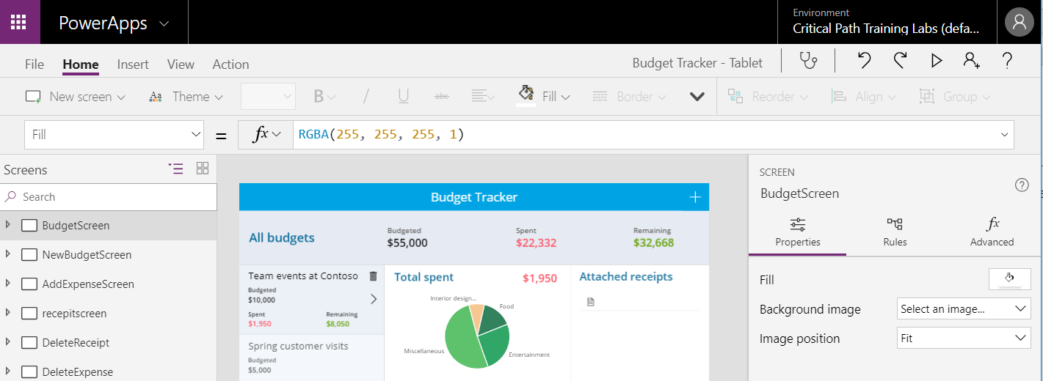
Running an App from Power Apps Studio
You can run the app using the Power Apps Studio toolbar
Run the app by clicking the Preview the App button
Stop a running app to return to design mode
Preview the app
Notes:
While you are building an app, you will want to periodically run the app in order to test it and make sure the app it does what you want it to do. The way that you run an app is by clicking the ‘Preview the app’ button in the toolbar in the upper right corner of Power Apps Studio. Running the app makes it possible to experience what the consumers of the app will see when they launch the app.
After running and testing an app, you must learn how to quit the app and return back to design view in Power Apps Studio. You can accomplish this by clicking the button with the X icon in the top, right corner of the App Preview window. You should become comfortable running and quitting apps in Power Apps studio because you will be doing that on a regular basis as you build apps.
When you begin to work with variables and collections (covered in the next lecture), you will see that it is often required to run the app to initialize variable and collection values. In other words, you cannot initialize a variable or a collection while the app is in design mode. Instead, you must run the app and execute the actions to initialize the values for variables and collections.

Slide 17
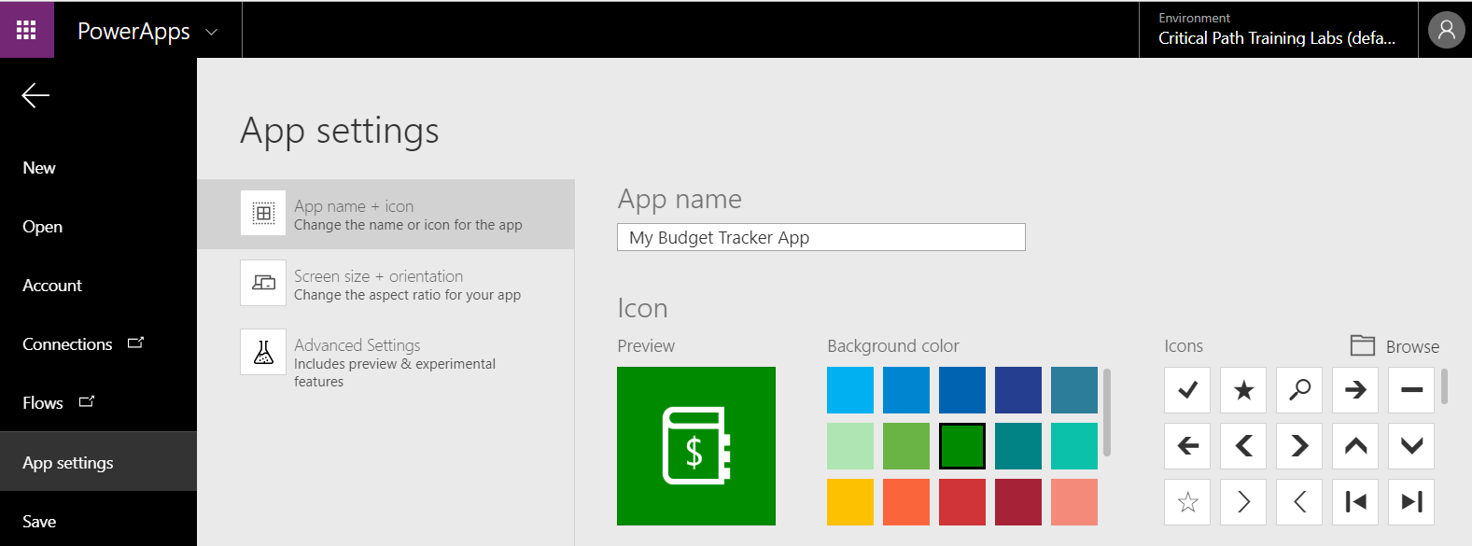
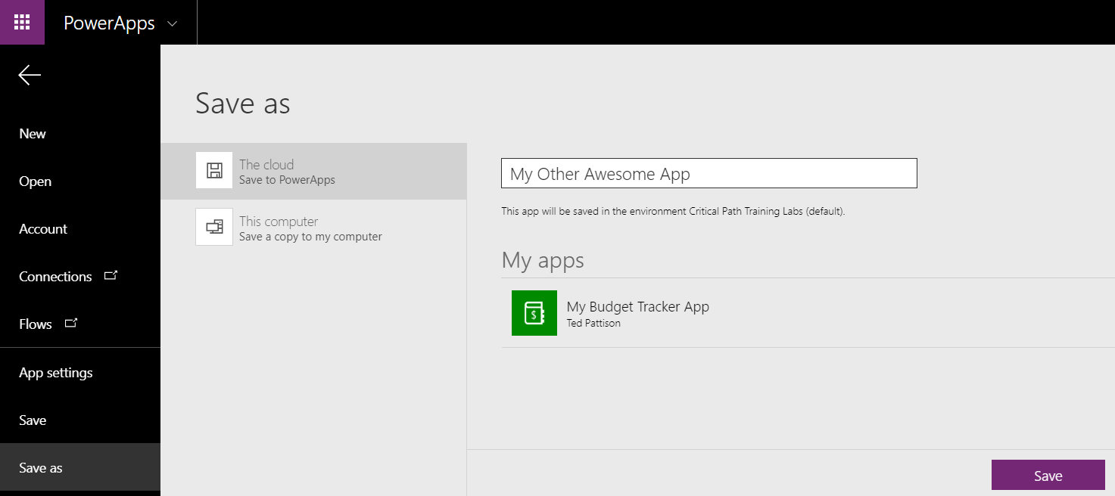
Saving an App to the Cloud
Before saving, first you should configure App settings
Save app to cloud using Save or Save As command
Notes:
When you create a new app from the Power Apps Home page, you are redirected from the URL of https://make.Power Apps.com over to Power Apps Studio at https://create.Power Apps.com. While you are building and testing an app, everything you do is simply stored in memory by the browser. If you close the browser without saving your work, then the app you are creating will be discarded. Therefore, you must save your app at periodic intervals to ensure you do not lose any work.
An app can be saved into storage in the cloud by using the Save command or the Save As command. However, before saving an app for the first time, you should navigate to the App settings page so you can enter an app title as well as configure the app color and the app icon. The App settings page also provides access to the settings for the app’s screen size and orientation as well as advanced settings which makes it possible to enable new features that are still in preview.
After you save an app, you can later return to it to run the app or to open it up in edit mode to continue developing it. The user who creates an app is automatically assigned as the app owner. By default, the app is not available to other users. However, you can share an app you have created with other users so they can play it and use it as an app consumer. You can also share an app with edit permissions so another user can open the app in edit mode and continue the design work by adding new screens and controls.

Slide 18
Creating an App with the Budget Tracker App Template

Slide 19
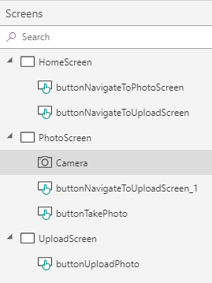
Building Apps using Screens and Controls
Screens provide the top-level objects in Power Apps UI
Your app must have one screen but can have multiple screens
You design screens by adding and configuring controls
Left tree view shows hierarchical view of screens and controls
You can rename screens and controls using left tree view menu
Notes:
Screens represent the top-level objects in any user interface you create with Power Apps. Every app must contain at least one screen. However, an app can have multiple screens and it’s common to add secondary screens when designing real-world apps. Note that only one screen can serve as the startup screen for an app. The screen which is located at the top of the left navigation menu is considered to be the startup screen. That means the top screen in the left navigation will be automatically displayed whenever the app is run. When you add secondary screens to an app you have created with Power Apps Studio, you must extend the app with extra behavior to display and navigate to these secondary screens.
You design screens by adding and configuring controls. Controls represent standard user interface elements such as buttons, labels, textboxes and combo boxes. When you want to add a new control, you must add it to a specific form. However, once you have added a control to a screen and configured its properties, you can copy that control to the clipboard and paste a copy of it into another screen within the same app.
The left navigation menu is important because it displays a hierarchical view of screens and controls that make up your app. Using the left navigation menu is often the best way to navigate to a particular screen or control. This is especially true once you have a screen with a large number of controls when it becomes hard to select the control you want in the Power Apps screen designer. Note that the left navigation menu also makes it possible to rename screens and controls to give them names that are more meaningful. While renaming screens and controls can be tedious, it is a good practice to get into because it makes apps easier to understand and to maintain.

Slide 20
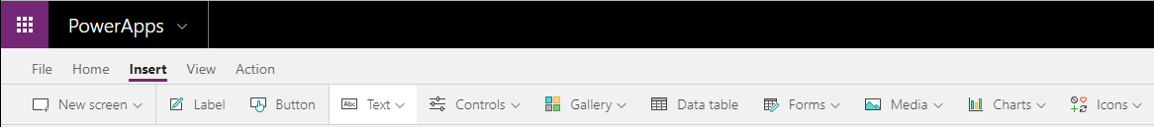
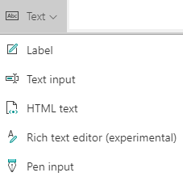
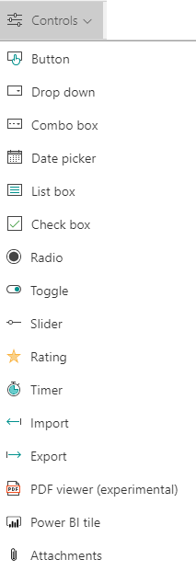
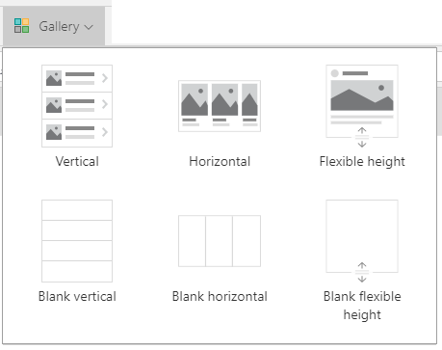
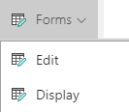
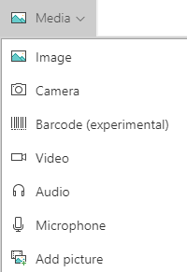
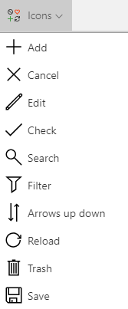
Adding Controls to a Screen
You add controls to a screen using the Insert ribbon tab
Power Apps provides extensive set of controls for web and mobile apps
Notes:
Power Apps provide an extensive set of controls for building whatever user experience your app requires. To create a new control, you should first select the correct screen in the left navigation and then navigate to the Insert tab in the ribbon. Next, you can use one of the dropdown menu buttons on the Insert tab to add the type of control you want.
The Text menu provides controls that deal with text values such as Labels and Textboxes. The Controls menu provides controls such as Combo Box, Date picker and Slider that provide a more convenient user experience for entering data. You can also add controls that support data binding such as a gallery, a display form or an edit form. These controls will be explained in more details over the next few slides.
Take a look at the controls available in the Media menu. As you can see there are controls such as Camera, Microphone and Barcode that can be used to build apps that take advantage of the capabilities of a modern mobile device such as an iPhone or an Android phone. There is also an Icons menu that makes it quick and easy to add style to an app by adding familiar icons for tasks such as saving, filtering and searching through data.

Slide 21
Agenda
Getting Started with the Power Platform
Creating Canvas Apps
Writing Power Apps Expressions
Working with Connectors and Data Binding
Understanding Delegation

Slide 22
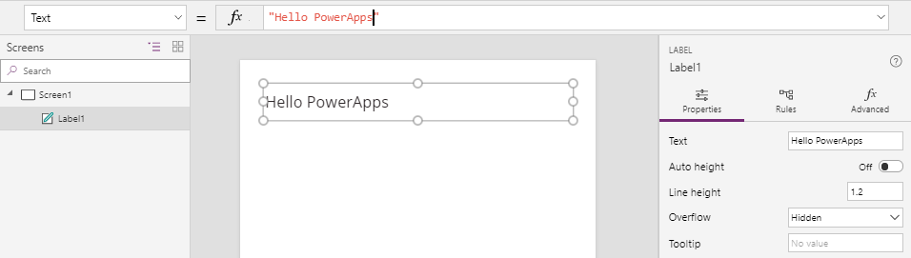
Configuring Control Properties
Control properties can be set two different ways
Property values can be set using Properties pane
Property values can be set using Formula bar
Building apps with Power Apps requires shift in thinking
You don’t write code to set property values like in VBA
Control properties configured using formulas
You develop using declarative style instead of procedural style
Notes:
When it comes to configuring the property values for a control, you have two choices. First, you can configure property values using the Properties pane on the right. In the example shown on the slide above, you can see that the Properties pane displays an editable textbox for the Text property of a Label control. This textbox in the Properties pane makes it possible to view and update the Text property of the label.
As an alternative to using the Properties pane, you can edit the Text property of a control using the Formula bar which is located above the Power Apps screen designer. To edit a control property using the Formula bar, you must first select the control. Next, you must select the property you want to configure in the property selector dropdown menu to the left of the Formula bar. After that, you can configure the control property by writing a formula in the Formula bar. In the example shown on the slide above, the formula in the Formula bar sets the Text property of the Label control. While the formula used in this example is just a static string value, you can write formulas which are dynamic. The ability to write dynamic formulas for screen and control properties adds a very important aspect to the Power Apps development model.
Let’s take a step back and think about how Power Apps allows you to set control properties using dynamic formulas. This leads to a development style that is quite different than times in the past when you may have written code in a programming language such as VBA, VB or C#. In these other languages, it is common to write procedural code that sets control properties. For example, you might write code behind the Reset button on a form to set the Text property of every textbox back to an empty string. This style of procedural coding is not the same style of development that you should be using when you begin working with Power Apps.
In Power Apps, you will not be writing any procedural code to set control properties. Instead, you configure control properties by writing formulas. Therefore, control properties take care of setting their own values. This leads to a development style in Power Apps that is ‘declarative’ instead of ‘procedural’. However, in order to master this new declarative style of development, you must first learn about the syntax of the Power Apps Formula Language.

Slide 23

Power Apps Formula Language
Power Apps provides its own Formula Language
Designed to be as similar as possible to Excel Formula language
Power Apps Formula Language includes built-in set of functions
You write formulas for specific properties
Set the Text property for a label
Set the Color property of the label text
Write an formula to filter the items shown in a gallery
Notes:
Power Apps defines its own Formula language for writing the formulas used to configure control properties. When Microsoft created the Power Apps Formula language, they tried to make it as similar as possible to the Excel Formula language. The reason for this is that are already 100 trillion (OK, maybe that’s an exaggeration) business users that know how to write formulas in an Excel workbook. Many Excel users will feel at home as they begin to write formulas in Power Apps because it uses a syntax and functions that they are already familiar with.
The Power Apps Formula language includes a built-in set of functions. Here are a few simple examples. You can use the Text function to apply formatting to a currency value. You can use the User function to return an object with information about the current user. You can use the Filter function to filter the set of records displayed in a Gallery control.
In the next module, you will see that Power Apps Formula language provides additional syntax for compound data structures such as tables and records. You will also learn that some functions provided by the Power Apps Formula language return a value while other perform an action. If you want to take a look at Microsoft documentation for this language, you can navigate to the following URL:
https://docs.microsoft.com/en-us/Power Apps/maker/canvas-apps/formula-reference

Slide 24
Input and Output Properties
Input only
Value based on formula which cannot be used in other formulas
Textinputbox1.Default (initial value)
Output only
Value cannot be set by formula but can be used on other formulas
Textinputbox1.Text (value always controlled by user input)
Input/Output
Value based on formula which can be used in other formulas
Textinputbox1.Fill
Notes:
There are three different type of control properties. A property can be input-only, input/output or output only.
The value of an input-only property can be set using a formula. However, the value of the property cannot be referenced in the formulas for other properties. The Default property of a texbox control is an example of an input-only property.
The value of a output-only property cannot be set using a formula. However, its value can be referenced in the formulas for other properties. The Text property of a texbox control is an example of an output-only property.
The value of a input/output property can be set using a formula and its value can be can be referenced in the formulas for other properties. The Fill property of a texbox control is an example of an input/output property.

Slide 25
Primitive Data Types
Power Apps formulas support native data types
Number: 3.141592
Text: "Hello World”
Boolean: True or False
DateTime: 3/27/2018 12:00PM
Date: 3/27/2018
Any type can contain blank (i.e. null) values
Test for null value using IsBlank() function
Set null value using Blank() function
Notes:
The Power Apps formula language supports a simple set of native data types including Number, Text, Boolean, DateTime and Date.
When you are inspecting values in a Power Apps formula, you must often deal with blank (i.e. null) values. You can test a property value or a variable value using the IsBlank() function to determine if it has a value or not. You can also use the Blank() function when you need to set a variable to a blank value.

Slide 26
Compound Data Types
Record
{ FirstName: "Chuck", LastName: "Sterling" }
Table
Table( { FirstName: "Chuck", LastName: "Sterling" },
{ FirstName: "Ted", LastName: "Pattison" } )
Shorthand for Table with one column named value
[ "Moe", "Curly", Larry" ]
Records and tables can be nested
Table can contain records of tables of records…
Record can contain tables of records of tables …
Notes:
The Power Apps formula language supports a few complex data types including the Record data type and the Table data type. Many of the functions you provided by the Power Apps formula language has input parameters and return values based on the Record data type and the Table data type.
You create instances of the Record data type using a JSON-like syntax with curly braces and name-value pairs joined by a colon and separated by commas. The Power Apps formula language also provides a Table function for scenarios where you want to hard-code the columns and values for a table into a formula.
Note that the Power Apps formula language provides convenient syntax (e.g. ["A", "B", "C"] ) for creating a table with one column. While this syntax appears to create string array, it's actually a table with a single value and that column is given an implicit name of Value.

Slide 27
Events and State Changes
Formulas for event properties can contain imperative logic
OnSelect, OnVisible, OnStart, etc.
Imperative logic is used to take action
Set value of global variable or context variable
Add item to a collection
Navigate between screens
Submit data to server
You can chain actions together with chaining operator (;)
Notes:
A large part of Power Apps development is based you writing control property formulas so that controls can take care of themselves. This is what is referred to as a declarative development model. However, there are still cases where you need to write formulas that contain procedural logic that executes in response to user actions such as clicking a button changing the value in a dropdown list.
Power Apps provides a set of event properties for screens and controls which makes it possible for you to write behavior formulas. Event property names always start with "On" such as OnSelect, OnChange, OnCheck and OnUncheck. The behavior formulas you write for an event property perform actions such as setting the value of variable, adding an items to a collection or navigating to another screen.
When you are writing procedural logic for an event property formula, you'll often find that you need to perform more than one action. That means you must learn how to combine multiple behavior formulas together into a single formula. To combine behavior formulas, you must include a semi-colon after every behavior formula except for the last one. Adding a semi-colon after the lasty behavior formula is optional.

Slide 28
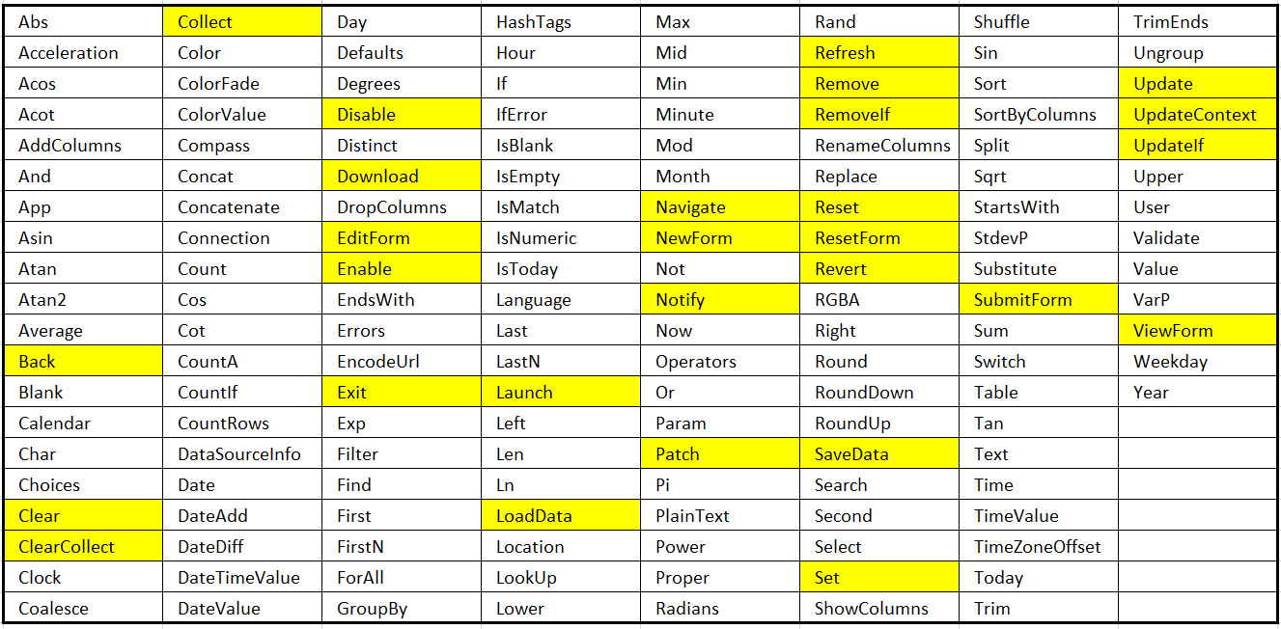
Declarative vs Imperative Functions
Non-highlighted functions used to return values
These are declarative functions
Highlighted functions used to perform actions
These are imperative functions
Notes:
When working with standard properties, you will write formulas that evaluate to a specific value. When writing this type of formula, you will typically use the functions shown on the slide above without highlighting because they are the ones which return a value instead of performing and actions.
When working with event properties, you will write formulas that perform actions. When writing this type of formula, you will typically use the functions shown on the slide above with highlighting because they are the ones which perform an action instead of returning a value.

Slide 29
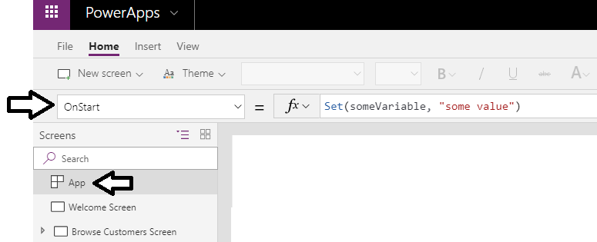
App OnStart
App OnStart property used to initialize state in app
Event provides support for initializing state in app
Commonly used to initialize app-level variables and collections
Right-click App in left navigation to run OnStart while in editor
Notes:
Power Apps provides a special event property on the App named OnStart. This event property provides you with a chance to execute behavior formulas when the application first starts. The OnStart event property is often used to initialize variable values and pre-load data from an external data source such as a database.
When you had one or more behavior formulas to the App OnStart event property, they do not automatically execute when editing a canvas ao in Power Apps Studio. To test the behavior formulas you have added to the App OnStart event property, you should right-click App node in the left navigation and select the Run OnStart command.

Slide 30
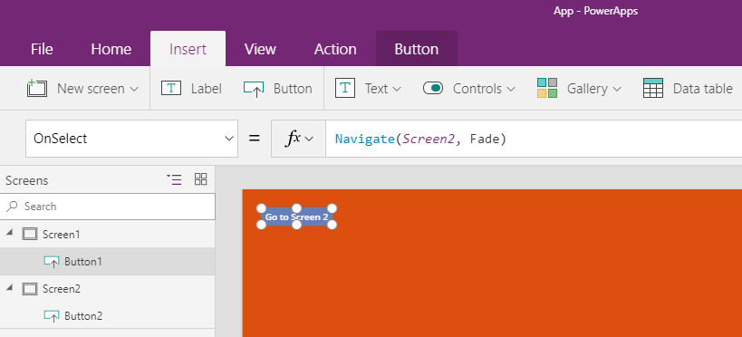
Navigating Between Screens
Navigate to a screen using Navigate function
Call Navigate function from OnSelect property of Button control
Navigate function performs action instead of returning a value
Notes:
When an app is run, Power Apps automatically displays the startup screen which is defined as the top screen in the Left Navigation menu. If you add secondary screens to an app, you must extend your app with the behavior to navigate to secondary screens. This can be accomplished by adding a Button control and configuring its OnSelect property with a formula that calls the Navigate function.
The Navigate function is an example of a function that performs an action instead of returning a value. When you call the Navigate function, the first parameter indicates the screen you want to display. The second parameters controls whether there will be a visual animation such as a fade when moving from one screen to another.
The Navigate function is complemented with a similar function named Back. The Back function provides the behavior of returning to the previous screen. For example, imagine you have an app that has a Customers screen that displays a list of customers and also a Customer screen that displays the data for a single customer at a time. On the Customers screen you can call the Navigate function to navigate to the Customer screen to display the data for a specific customer. The Customer screen could provide a Button control with an OnSelect property which calls the Back function to navigate back the Customers screen.

Slide 31
Agenda
Getting Started with the Power Platform
Creating Canvas Apps
Writing Power Apps Expressions
Working with Connectors and Data Binding
Understanding Delegation

Slide 32
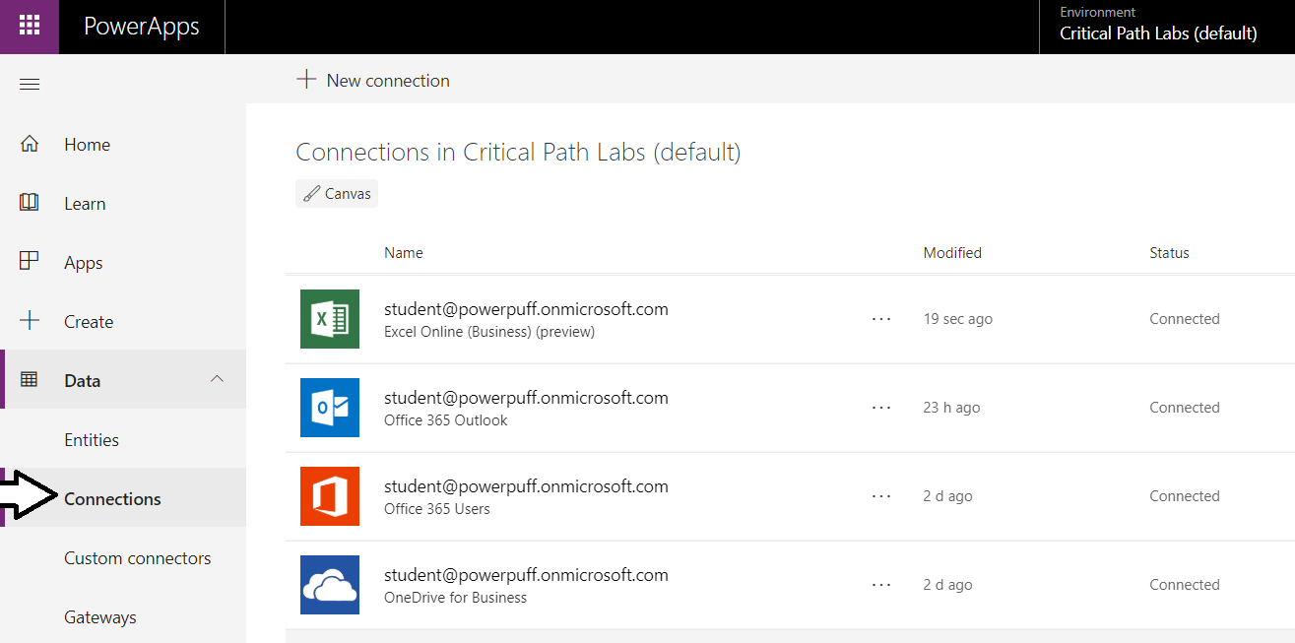
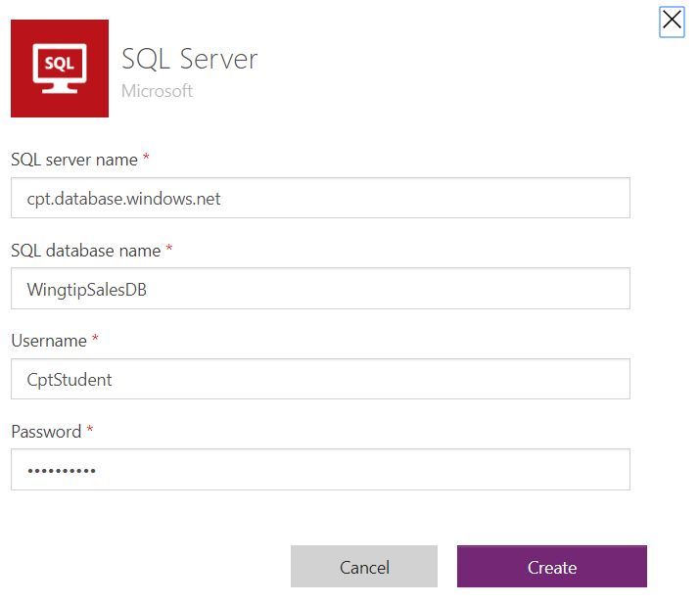
Understanding Connectors & Connections
What is a Connector?
API wrapper that Power Apps uses to interact with datasource
What is a Connection?
Configuration created to connect to a specific datasource
Each connection is created using a specific connector
Connection also caches login credentials and granted permissions
Connections can be shared across users
Notes:
One of the strengths of Power Apps is that it makes it relatively easy to build an app that connects to data. Keep in mind that the data you need to access may be stored in many different types of datasources. You bring that data into your app by creating connections. Each connection is created by a specific user and may be shared across users. If you navigate to the Power Apps home page, you can see your current set of connections by navigating to Data > Connections node in the left navigation menu as shown in the screenshot in the slide above.
To become proficient at building apps with Power Apps, you must learn the key concepts involved with connectors. A connector is a wrapper around an API that Power Apps uses to interact with a specific type of datasource. Each connection you create is based on a specific connector which knows how to communicate with the datasource to which you are connecting. Power Apps provides out-of-the-box connectors for many popular services and on-premises datasources including SQL Server, SharePoint, OneDrive for Business, Azure AD, Dynamics 365, Salesforce and Twitter.
There are two important aspects of connectors and connections that relate to security. When using a connection for the first time, the user is often prompted to provide security credentials such as a user name and password to establish a secure connection to the datasource. After the user supplies security credentials the first time, the connection is able to cache those credentials and reuse them to reestablish connections to that datasource in the future without any need for user interaction.
The second security-related aspect of connections has to do with users delegating permissions to an app. A connection often allows an app to read and write to a datasource on behalf of the current user. Power Apps prompts users with an interactive dialog which allows a user to grant permissions to a connection which is required in order to read and write to a datasource on a user’s behalf.

Slide 33
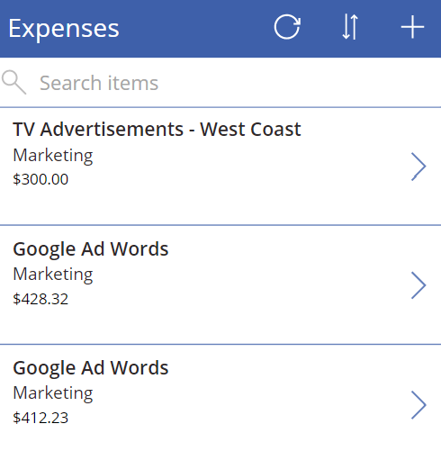
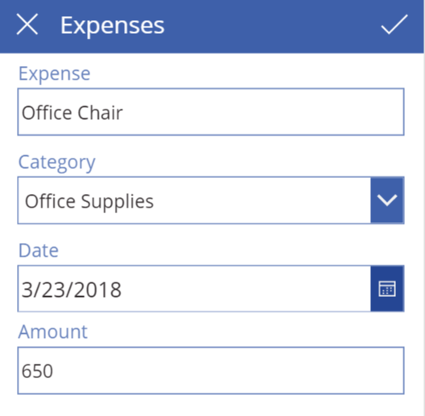
Data Binding with Galleries and Forms
Table binding
Gallery control
DataTable control
Single-record binding
Display form control
Edit form control
Notes:
Data binding is one of the key features in Power Apps that dramatically simplifies the process of building an app to access data. When you create a new app using the ‘Start from data’ template, Power Apps Studio will use data binding when it generates the connection, the screens and the controls for the app. This means you can use data binding without really understanding how it works. However, learning how data binding really works in Power Apps will help you become a better app builder.
Data binding in Power Apps is based tabular data which is laid out in terms of tables and records. Some controls support data binding to a table of records while other controls support binding to a single record at a time. The Gallery control and the DataTable control are examples of controls that can be bound to a table of records. For example, you can create a Gallery control to display a set of expenses.
Forms are a special type of control that support data binding with a single record of data at a time. You can use a Display Form control when you want to display a single record of data in a read-only fashion. You can use an Edit Form control when you want to build a screen that allows a user to add a new record or to edit an existing record.

Slide 34
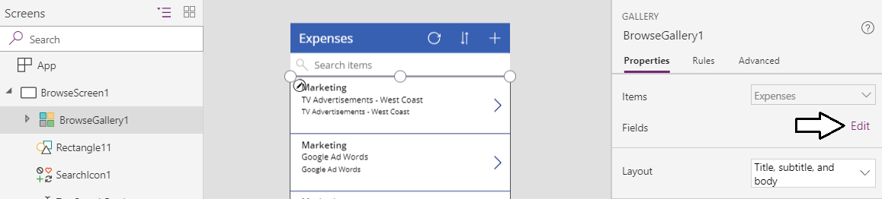
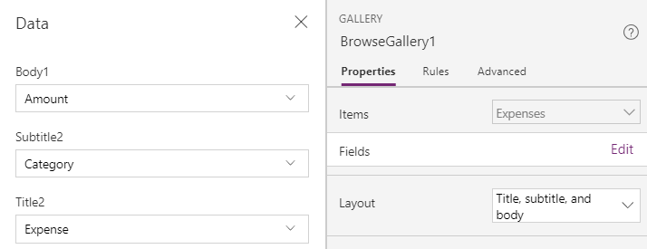
Working with the Data Pane
You use the Data pane to configure data binding
Select a data-bound control and then display Data pane
Data pane allows you to change layout for data binding
Once you select layout, you can then map fields below
Notes:
In order to customize the way data binding works, you must learn to use the Data Pane in Power Apps Studio. You use the Data Pane when you need to configure or customize the data binding for a data bound control such as the Gallery control. In order to use the Data pane, you must first select the data-bound control in the left navigation and then you can open the Data pane by navigating to the View tab in the ribbon and clicking the Data sources button. When a Gallery control is selected, the Data pane shows the details of the data binding including the connection, the data binding layout and the field mappings. It’s easy to switch back and forth between different layouts and to update the field mappings to creating a better view of the underling data.
There is a common design pattern used in Power Apps where an app is created with three screens including (1) a browser screen, (2) a detail screen and (3) an edit screen. All three screens are used to data bind to the same underlying table. The browser screen contains a Gallery control with data binding to display many records at once. The detail screen uses a Display Form control to display the data for a single record in a read-only fashion. The edit screen contains an Edit Form control which allows users of the app to add new records and edit existing records.

Slide 35
Creating an App using the Start from Data Template

Slide 36
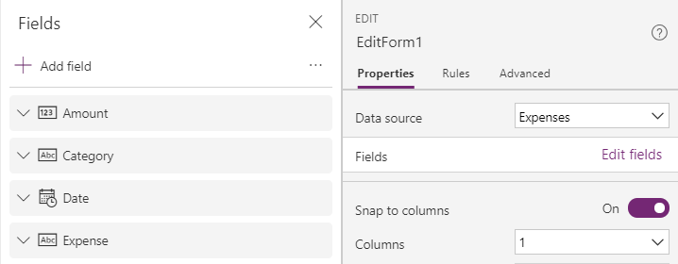
Understanding Forms and Data Cards
Form acts as a container for data cards
Each form binds to a single record
Within a form, each data card binds to an underlying field
Each data card contains an encapsulated set of child controls
Notes:
In Power Apps, you use display forms and edit forms for scenarios where you need to bind to a single record at a time. Display forms and edit forms act as containers that hold another type of control known as a 'data card’ which is also called a 'card control'. Each form contains a set of data cards that bind to individual fields from the underlying record. Each data card has a DataField property that determines which field it binds to within the underlying record.
A data card contains its own set of child controls. The child controls inside a data card make up the experience for displaying and editing a single field. For example, a number data card may consist of a Label control to provide the display name of the field and a Text input control to provide an editor for the value of the field. Most of the data cards supplied by Power Apps also provide a label control to display any validation errors that occur due to bad user input.
When you are writing a formula for a Form control property and a data card propertythe current record is available using an object named ThisItem. The ThisItem object for a Form control contains properties for each field in the underlying record.
When you are writing a formula for the properties of a child control inside of a data card, you can use the Parent object. For example, a child control inside a data card should use Parent.Default to read the initial state of the field from the data source. By using Parent instead of directly accessing the information that you want, the data card is better encapsulated. That means you can use the same data card with multiple fields in the same record without breaking internal formulas.

Slide 37
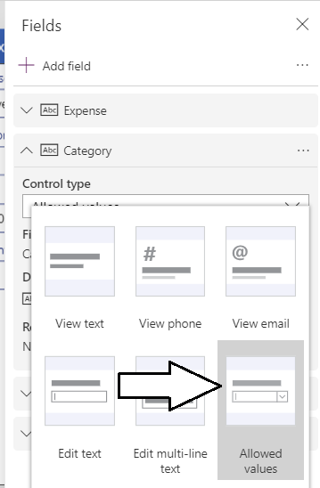
Changing a Field’s Data Card Type
Fields in Form control get default data card
Use Data pane to change data card used by any field
Different data cards offer different editing experiences
Notes:
Power Apps provides several different types of data cards which can be used with various data types to create customized user interface experiences. When you use the ‘Start from data’ template to create a new app, Power Apps automatically generates a new view form and a new edit form for you with a default set of data cards.
Sometimes Power Apps will create a default set of data cards that isn’t exactly what you want. However, you can swap out the default data card used for a field with a different type of data card that improves the user experience. For example, imagine you have an Expenses table with a Category field which only allows 4 predefined category values. You can change the default data card which uses a standard textbox to a different data card that supplies the user with a dropdown list of choices.
Working with data cards can be a little tricky at first because you must select the form in the left navigation and then display the Data pane. Once you’ve done that, you can then view and edit the type of data card used for each field. The slide above shows an example of changing from a data card with a textbox over to a better data card named ‘Allowed Values’ that provides a dropdown menu.

Slide 38
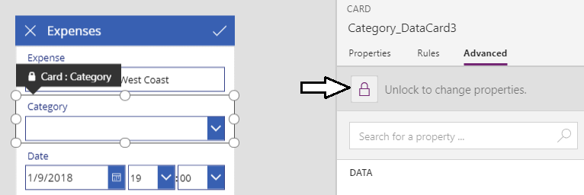
Customizing a Data Card
By default, data cards are locked and cannot be edited
In many scenarios, you should leave data cards locked
Some scenarios call for unlocking data cards to customize them
Notes:
The standard data cards provided by Microsoft are locked by default. When a data card is locked, you can modify a small number of properties of the data card and child controls inside. If a property is locked and can't be modified, it appears in the Property pane with a lock icon next to its name.
In many cases, leaving data cards in their locked state is helpful because it prevents you from making unintended changes that could disrupt the way that data binding is working. In other cases where the data card requires some customization, you’ll be required to unlock a data card so you can edit all aspects of its properties and its child controls.
You can unlock a data card by navigating to the Advanced pane on the right with the data card selected and clicking the button with the lock icon with the caption ‘Unlock to change properties’. Once the data card is unlocked, you are free to customize the child controls of a data card by resizing them, moving them or hiding them. You might also want to add new child controls to a data card to achieve a particular user interface experience. It’s also possible to start with an entirely blank data card known as a ‘custom card’ which allows you to add all the child controls from scratch.

Slide 39
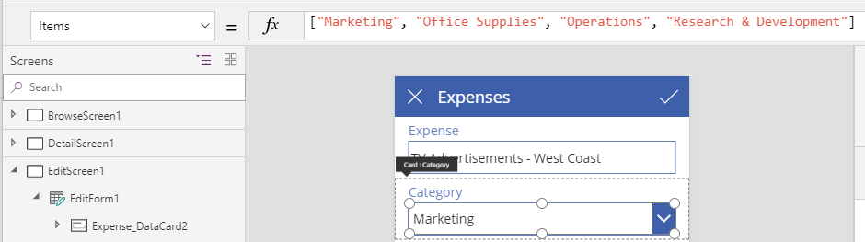
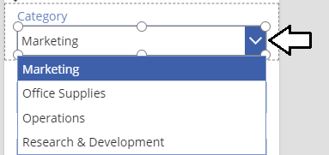
Populating a Dropdown Combobox
Once a data card is unlocked you can customize it
Add formula for Items property to populate combo box
Dropdown list provides better user experience than textbox
Notes:
Here is a common example of when it is necessary to unlock a data card. Let’s say you can change the data card used for a text field to use the Allowed Values data card which provides a user experience with a dropdown menu of predefined choices. When you first update the field to use the Allowed Values data card, all the child controls are locked so you cannot configure the dropdown menu with a set of values.
Once you unlock an Allowed Values data card, you can then write a custom formula for the Items property of the child control which provides the dropdown menu. The screenshot on top in the slide above shows how to write a formula for the Items property to populate the set of choices provided by this dropdown menu. The screenshot on the bottom of the slide shows what the dropdown menu looks like to a user who is a consumer of the app.

Slide 40
Customizing Forms and Data Cards

Slide 41
Agenda
Getting Started with the Power Platform
Creating Canvas Apps
Writing Power Apps Expressions
Working with Connectors and Data Binding
Understanding Delegation

Slide 42
Table Functions
Each table represented as a value
Table can be passed as argument
Table can be returned by function
Functions that return tables
Filtering: Filter, Search
Sorting: Sort, SortByColumns
Shaping: AddColumns, DropColumns, RenameColumns
Grouping: GroupBy, Ungroup
Notes:
The Power Apps formula language has quite a few functions which accept tables as input parameters and return tables as the function return values. Becoming familiar with these functions is important because they provide the essential behavior such as filtering and sorting tabular data.
You can filter a table using either the Filter function of the Search function. You can sort a table using a single column using the Sort function. If you need to sort a table by two or more columns you can use the SortByColumns function. The AddColumns functions allows you add a calculated columns. You can also use the DropColumns function or the RenameColumns to change the layout a columns within a table. You can also perform or reverse aggregate operations using the GroupBy function or the Ungroup function.

Slide 43
Understanding Delegation
Delegation is act of pushing work to data source
Work usually involves filtering and sorting
Work can also involve aggregation
Delegation minimizes amount of data retrieved by app
Not all connectors support delegation
Non-delegate-able connectors only return 500 items
Searching through data becomes unpredictable
Notes:
Delegation is an important concept that should be understood by anyone building canvas apps. The central concept of delegation is that a canvas app can request that certain data operations such as filtering and sorting be performed in the backend by the external data source. In scenarios where delegation cannot occur, all data operations must performed on the client side by in the canvas app itself. Delegation is important because it minimizes amount of data returned to your canvas apps.
It's important to understand that some connectors support delegation and other connectors do not. Data sources such as Azure SQL Server, SharePoint Online and the Common Data Service have strong support for delegation. However, the OneDrive for Business connector that let's you read and write rows in a table in an Excel workbook does not support any level of delegation.
The Power Apps connector infrastructure provides a safeguard that prevents a poorly-written canvas app from retrieving large sets data that could never be handled in a performant manner. The default limit to the number of items that can be retrieved at once is 500 and this value can be configured up to 2000 on a per-canvas-app basis. Note that non-delegate-able connectors can only return the first 500 items and operations such as search become unpredictable if the number of items in the backend data source are larger than 500.

Slide 44
Delegate-able Functions
Filter functions
Filter, Search, and LookUp can be delegated
Sorting functions
Sort and SortByColumns can be delegated
Aggregate functions
Sum, Average, Min, and Max can be delegated
Not all data sources support this delegation
Notes:
There are several different Power Apps functions you can use to delegate data operations to the backend data source.
There is filtering functions that support delegation such as Filter, Search and LookUp. There are also delegatale sorting functions such as Sort and SortByColumns. Some connectors such as the one for SQL Server evn support delegation for aggregate functions such as Sum, Average, Min and Max.
You can read more about delegation at https://Power Apps.microsoft.com/en-us/tutorials/delegation-list.

Slide 45
Summary
Getting Started with the Power Platform
Creating Canvas Apps
Writing Power Apps Expressions
Working with Connectors and Data Binding
Understanding Delegation

